Slide 1
Cantor-Russel-Project
Angela Keller, Damaris Meier, Jasmin Sert, Julien Del Don, Corina Masanti
Lecture ESE: Introduction to Software Engineering
^{HS 2017}
^{Prof. Dr. Oscar Nierstrasz}

Slide 2
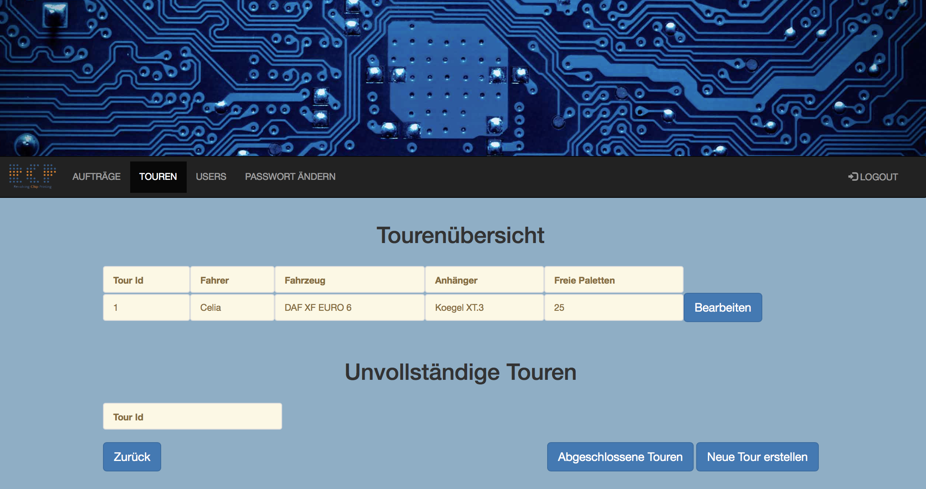
Goals
Focus on simplicity and usage
Easy to use for the employees
Driver-view on mobile
Linear Process
Everything is done step-by-step (example New Tour)
Keeping our customer happy ☺

Slide 3
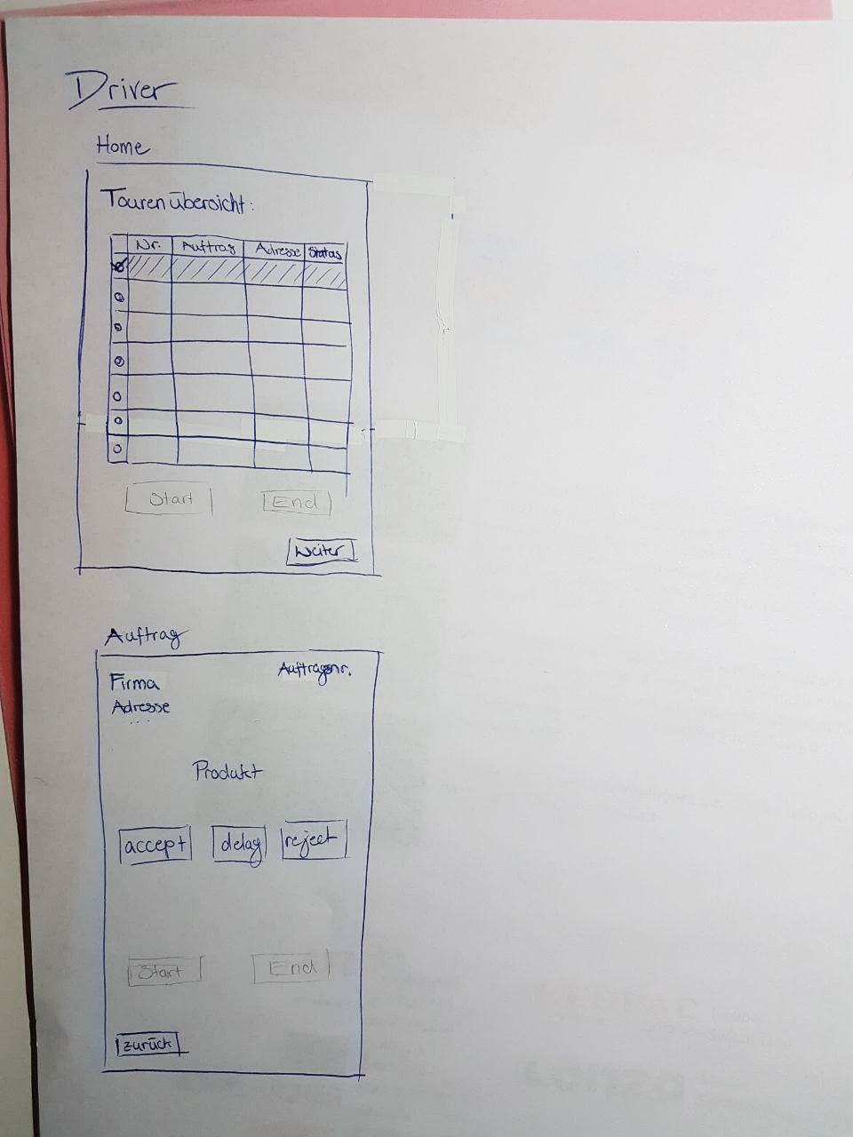
Procedure
Functionalities
Sketches
Kick Off
Writing Tests

Slide 4
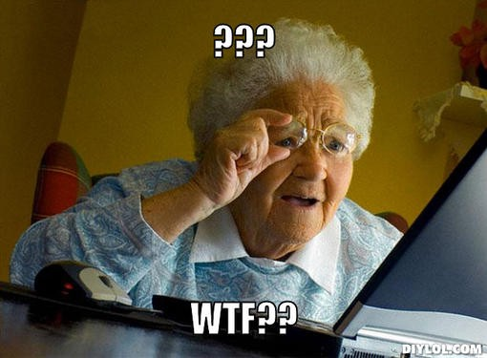
Problems
No experience: Thrown into cold water
Difficulties at the beginning
Getting started
Planing the structure
Scheduling
Assign tasks
What are the important tasks?
Who can do it?
Spring Magic

Slide 5

Highlights
Eye opening moments (after some long hours)
Learning outcome
Working end product
Teamwork

Slide 6
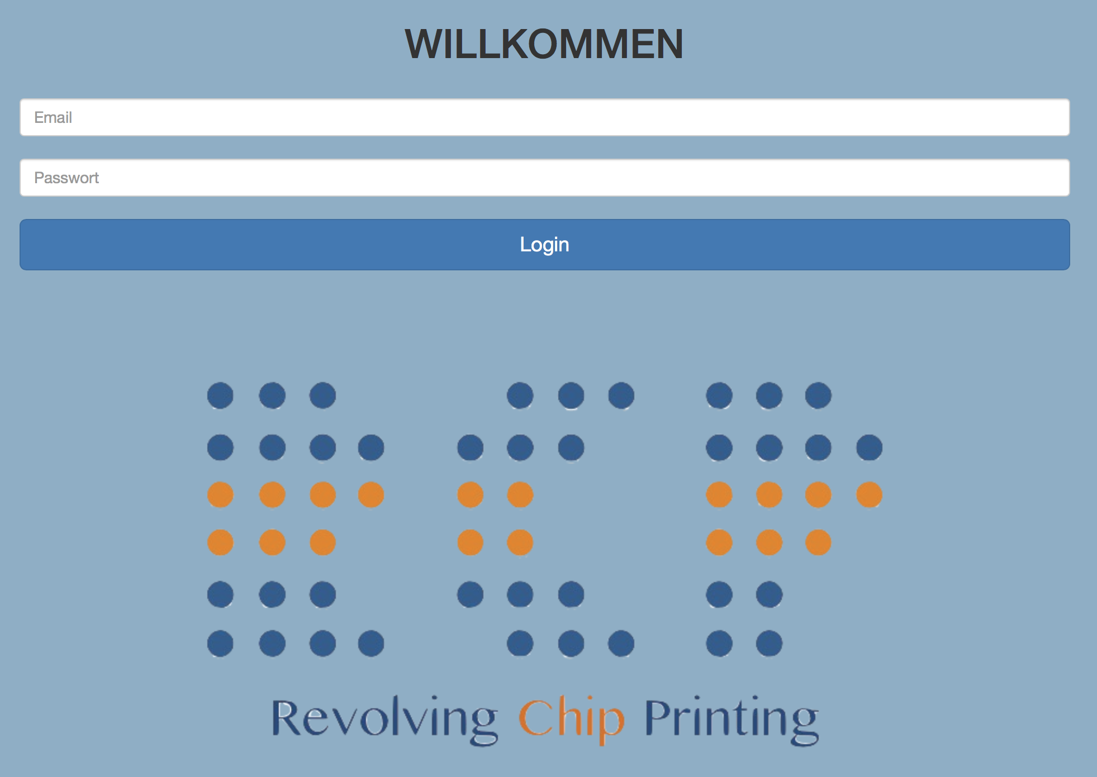
Demo

